Slide 1

Parallel & Distributed Computing
Lecture 20:
Concurrency Control
Farhad M. Riaz
Farhad.Muhammad@numl.edu.pk
Department of Computer Science
NUML, Islamabad

Slide 2
Mutual exclusion
Mutual exclusion is a concurrency control property which is introduced to prevent race conditions.
It is the requirement that a process can not enter its critical section while another concurrent process is currently present or executing in its critical section i.e only one process is allowed to execute the critical section at any given instance of time.

Slide 3
Mutual exclusion in single computer system Vs. distributed system
In single computer system, memory and other resources are shared between different processes.
The status of shared resources and the status of users is easily available in the shared memory so with the help of shared variable (For example: Semaphores) mutual exclusion problem can be easily solved.

Slide 4
Mutual exclusion in single computer system Vs. distributed system
In Distributed systems, we neither have shared memory nor a common physical clock and there for we can not solve mutual exclusion problem using shared variables.
To eliminate the mutual exclusion problem in distributed system approach based on message passing is used.
A site in distributed system do not have complete information of state of the system due to lack of shared memory and a common physical clock.

Slide 5
Mutual exclusion in single computer system Vs. distributed system
Requirements of Mutual exclusion Algorithm:
  No Deadlock:
  Two or more site should not endlessly wait for any message that will never arrive.
  No Starvation:
  Every site who wants to execute critical section should get an opportunity to execute it in finite time. Any site should not wait indefinitely to execute critical section while other site are repeatedly executing critical section
  Fairness:
  Each site should get a fair chance to execute critical section. Any request to execute critical section must be executed in the order they are made i.e Critical section execution requests should be executed in the order of their arrival in the system.
  Fault Tolerance:
  In case of failure, it should be able to recognize it by itself in order to continue functioning without any disruption.

Slide 6
Mutual exclusion in single computer system Vs. distributed system
Solution to distributed mutual exclusion:
  As we know shared variables or a local kernel can not be used to implement mutual exclusion in distributed systems.
    Message passing is a way to implement mutual exclusion.

Slide 7
Algorithms
Lamport’s
Ricart–Agrawala
Maekawa’s Algorithm

Slide 8
Mutual exclusion in single computer system Vs. distributed system
Token Based Algorithm:
  A unique token is shared among all the sites.
  If a site possesses the unique token, it is allowed to enter its critical section
  This approach uses sequence number to order requests for the critical section.
  Each requests for critical section contains a sequence number.
  This sequence number is used to distinguish old and current requests.
  This approach insures Mutual exclusion as the token is unique

Slide 9
Transaction Support
  Transaction
  Action, or series of actions, carried out by user or application, which accesses or changes contents of database.
Logical unit of work on the database.
Application program is series of transactions with non-database processing in between.
Transforms database from one consistent state to another, although consistency may be violated during transaction.

Slide 10
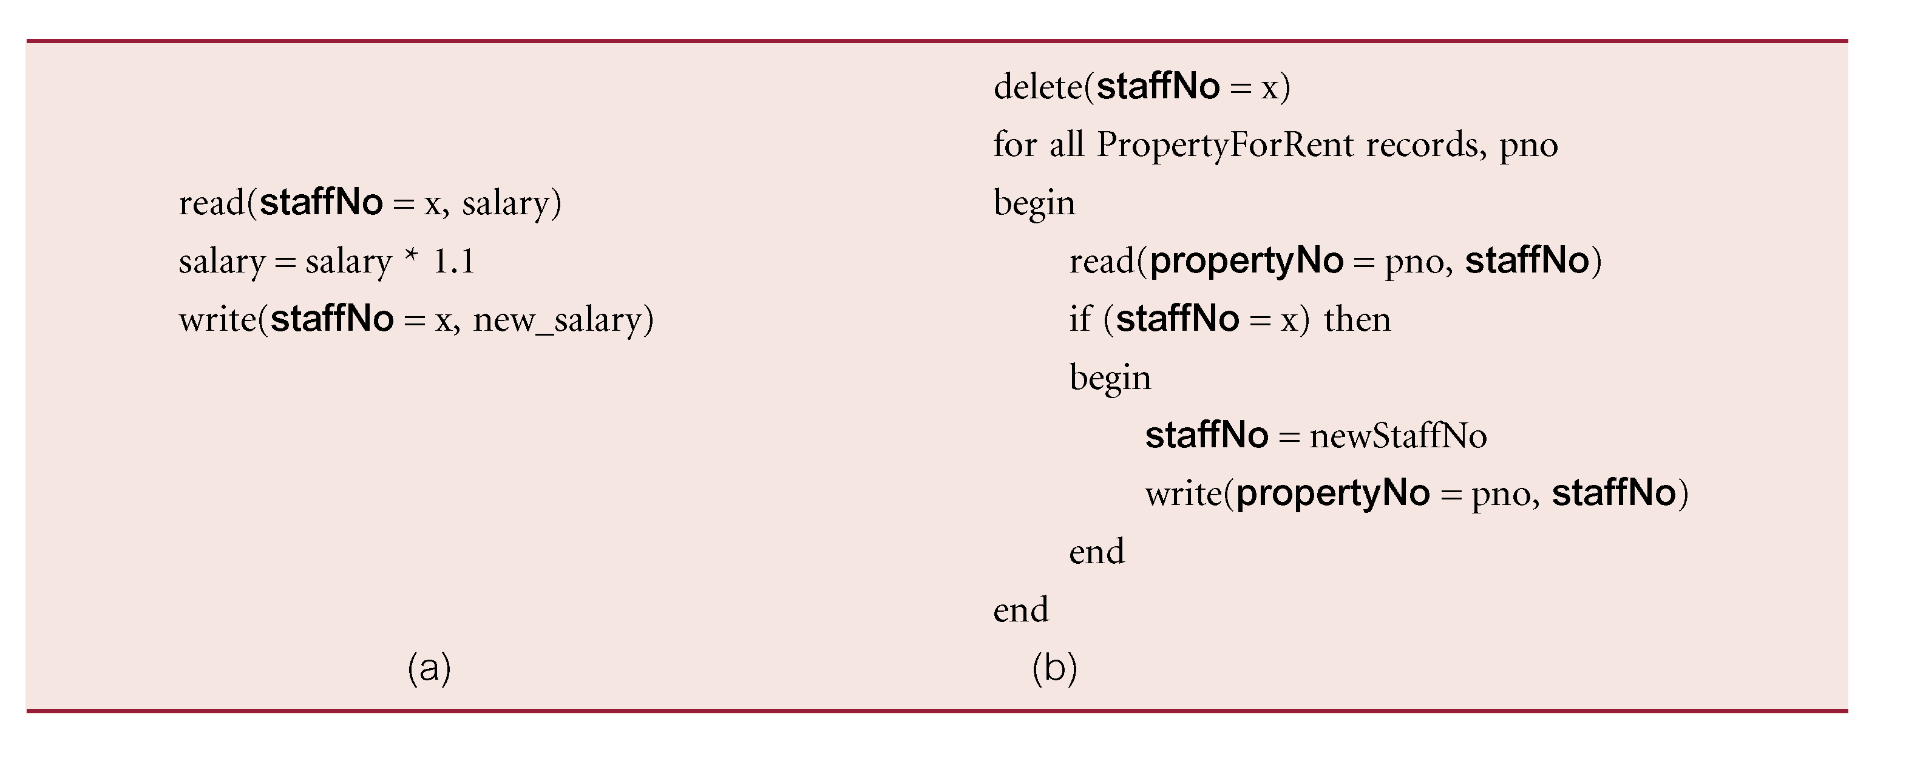
Example Transaction

Slide 11
Example Database
Consider an airline reservation example with the relations:
  FLIGHT(FNO, DATE, SRC, DEST, STSOLD, CAP)
  CUST(CNAME, ADDR, BAL)
  FC(FNO, DATE, CNAME,SPECIAL)

Slide 12
Example Transaction – SQL Version
Begin_transaction Reservation
begin
  input(flight_no, date, customer_name);
  EXEC SQL UPDATE FLIGHT
    SET STSOLD = STSOLD + 1
    WHERE FNO = flight_no AND
    DATE = date;
  EXEC SQL INSERT
    INTO FC(FNO, DATE, CNAME, SPECIAL);
    VALUES (flight_no, date, customer_name, null);
  output(“reservation completed”)
end . {Reservation}

Slide 13
Termination of Transactions
Begin_transaction Reservation
begin
  input(flight_no, date, customer_name);
  EXEC SQL SELECT STSOLD,CAP
    INTO temp1,temp2
    FROM FLIGHT
    WHERE FNO = flight_no AND DATE = date;
  if temp1 = temp2 then
    output(“no free seats”);
    Abort
  else
    EXEC SQL UPDATE FLIGHT
    SET STSOLD = STSOLD + 1
    WHERE FNO = flight_no AND DATE = date;
    EXEC SQL INSERT
    INTO FC(FNO, DATE, CNAME, SPECIAL);
    VALUES (flight_no, date, customer_name, null);
  Commit
  output(“reservation completed”)
endif
end . {Reservation}

Slide 14
Example Transaction – Reads & Writes
Begin_transaction Reservation
begin
    input(flight_no, date, customer_name);
    temp ← Read(flight_no(date).stsold);
    if temp = flight(date).cap then
    begin
      output(“no free seats”);
      Abort
    end
    else begin
      Write(flight(date).stsold, temp + 1);
      Write(flight(date).cname, customer_name);
      Write(flight(date).special, null);
      Commit;
      output(“reservation completed”)
    end
end. {Reservation}

Slide 15
Transaction Support
Can have one of two outcomes:
  Success - transaction commits and database reaches a new consistent state.
  Failure - transaction aborts, and database must be restored to consistent state before it started.
  Such a transaction is rolled back or undone.
Committed transaction cannot be aborted (Compensating transaction).
Aborted transaction that is rolled back can be restarted later.

Slide 16
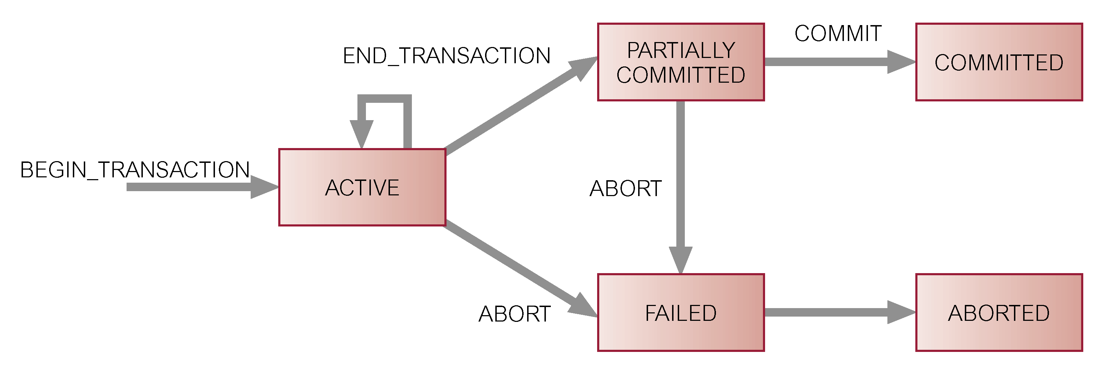
State Transition Diagram for Transaction

Slide 17
Properties of Transactions
Four basic (ACID) properties of a transaction are:
Atomicity
All or nothing’ property.
Consistency
Must transform database from one consistent state to another.
Isolation Partial effects of incomplete transactions should not be visible to other transactions.
Durability Effects of a committed transaction are permanent and must not be lost because of later failure.

Slide 18
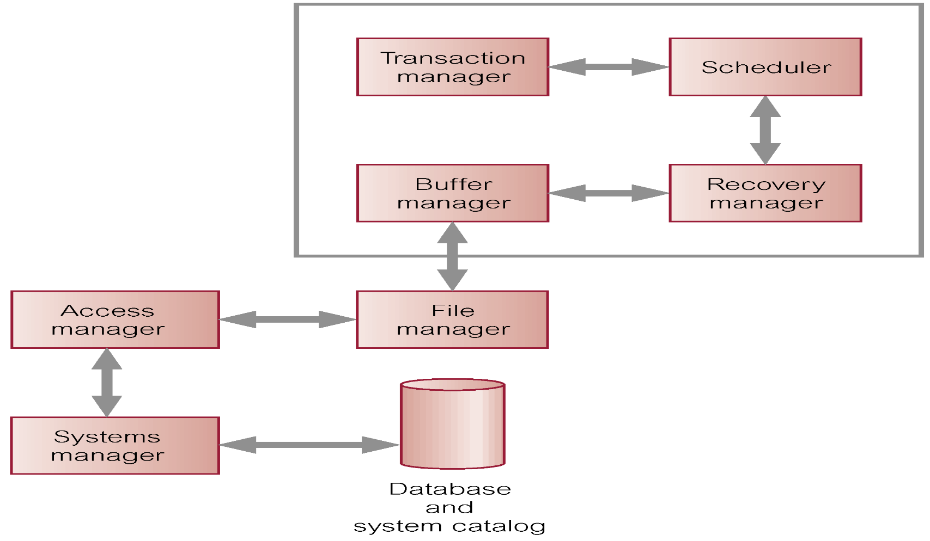
DBMS Transaction Subsystem

Slide 19
Architecture Revisited
Begin_transaction,
Read, Write,
Commit, Abort
Results
Distributed
Execution Monitor
Transaction Manager
With other
(TM)
With other
TMs
Scheduling/
Descheduling
Requests
SCs
Scheduler
(SC)
To data
processor

Slide 20
Centralized Transaction Execution
User
Application
User
Application
…
Begin_Transaction,
Read, Write, Abort, EOT
Results &
User Notifications
Transaction
Manager
(TM)
Read, Write,
Abort, EOT
Results
Scheduler
(SC)
Scheduled
Operations
Results
Recovery
Manager
(RM)

Slide 21
Distributed Transaction Execution
User application
Begin_transaction,
Read, Write, EOT,
Abort
Results &
User notifications
Distributed
Transaction Execution
Model
TM
TM
Replica Control
Protocol
Read, Write,
EOT, Abort
Distributed
Concurrency Control
Protocol
SC
SC
Local
Recovery
Protocol
RM
RM

Slide 22
Concurrency Control
Concurrency (Throughput)
  Process of managing simultaneous operations on the database without having them interfere with one another.
  Prevents interference when two or more users are accessing database simultaneously and at least one is updating data.
  Although two transactions may be correct in themselves, interleaving of operations may produce an incorrect result.

Slide 23
Need for Concurrency Control
Three examples of potential problems caused by concurrency:
  Lost update problem.
  Uncommitted dependency problem.
  Inconsistent analysis problem.

Slide 24
Lost Update Problem
Occurs when successfully completed update by one transaction is overwritten by another transaction.
And ultimate result is not correct.

Slide 25
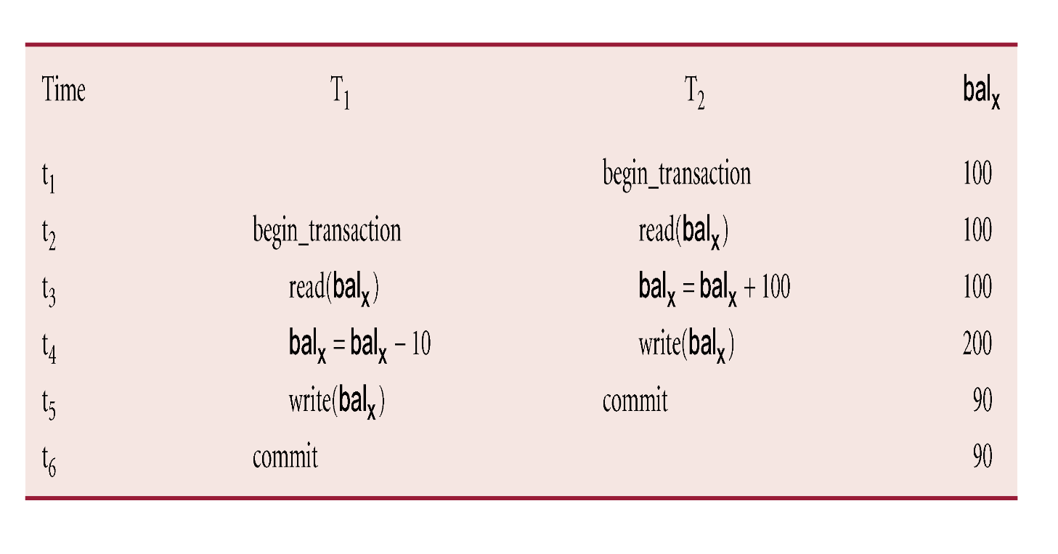
Lost Update Problem
Loss of T₂’s update avoided by preventing T₁ from reading bal_{x} until after update.

Slide 26
Lost Update Problem
Successfully completed update (by T2) is overridden by another user (by T1).
T₁ withdrawing £10 from an account with bal_{x}, initially £100.
T₂ depositing £100 into same account.
Serially, final balance would be £190
BUT due to lost update it becomes £ 90.

Slide 27
Uncommitted Dependency Problem
Occurs when one transaction can see intermediate results of another transaction before it has committed.

Slide 28
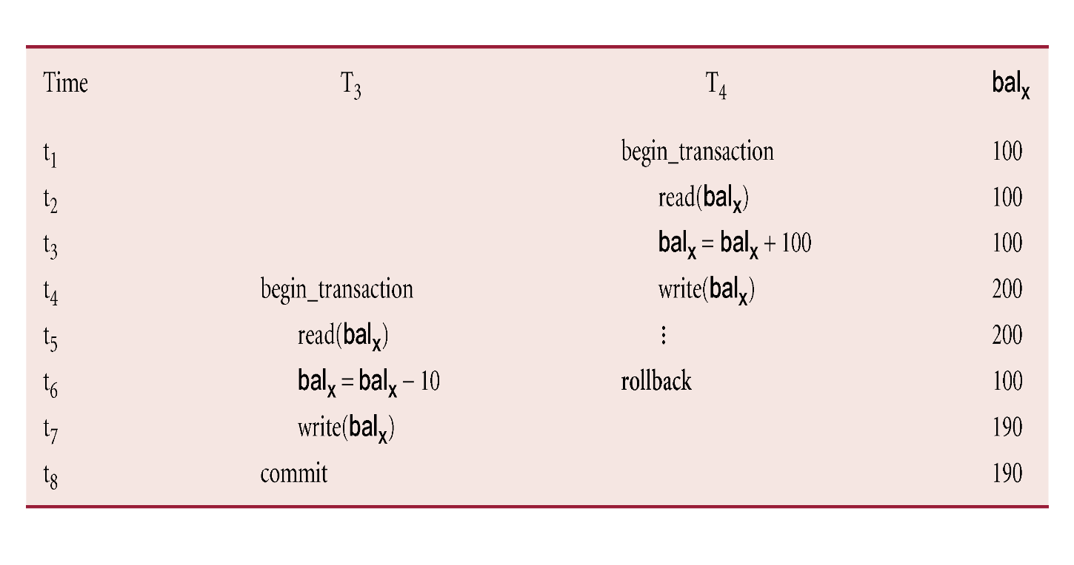
Uncommitted Dependency Problem
Problem avoided by preventing T₃ from reading bal_{x} until after T₄ commits or aborts.

Slide 29
Concurrency Control
A control or mechanism that avoids or manages any kind or interference during the execution of concurrent (simultaneous) transactions.

Slide 30
Concurrency Control Techniques
Two basic concurrency control techniques:
  Locking,
  Timestamping.
Both are conservative approaches: delay transactions in case they conflict with other transactions.
Optimistic methods assume conflict is rare and only check for conflicts at commit.

Slide 31
Locking
Transaction uses locks to deny access to other transactions and so prevent incorrect updates.
Most widely used approach to ensure serializability.
Generally, a transaction must claim a shared (read) or exclusive (write) lock on a data item before read or write.
Lock prevents another transaction from modifying item or even reading it, in the case of a write lock.

Slide 32
Locking - Basic Rules
If transaction has shared lock on item, can read but not update item.
If transaction has exclusive lock on item, can both read and update item.
Reads cannot conflict, so more than one transaction can hold shared locks simultaneously on same item.
Exclusive lock gives transaction exclusive access to that item.

Slide 33
Locking-Based Algorithms
Transactions indicate their intentions by requesting locks from the scheduler (called lock manager).
Locks are either read lock (rl) [also called shared lock] or write lock (wl) [also called exclusive lock]
Read locks and write locks conflict (because Read and Write operations are incompatible
rl wl
rl yes no
wl no no
Locking works nicely to allow concurrent processing of transactions.

Slide 34
Strict 2PL
Hold locks until the end.
Obtain lock
No. of locks
Release lock
Transaction
duration
BEGIN
END
period of
data item
use

Slide 35
Centralized 2PL
There is only one 2PL scheduler in the distributed system.
Lock requests are issued to the central scheduler.
Data Processors at
participating sites
Coordinating TM
Central Site LM
Lock Request
Lock Granted
Operation
End of Operation
Release Locks

Slide 36
Distributed 2PL
2PL schedulers are placed at each site. Each scheduler handles lock requests for data at that site.
A transaction may read any of the replicated copies of item x, by obtaining a read lock on one of the copies of x. Writing into x requires obtaining write locks for all copies of x.

Slide 37
Distributed 2PL Execution
Coordinating TM
Participating LMs
Participating DPs
Lock Request
Operation
End of Operation
Release Locks

